Slide 1
Boolean Algebra and
Logic Simplification
Boolean algebra is the mathematics of digital systems.
Helps in the study and analysis of logic circuits.

Slide 2
Boolean Operations and Expressions
Definition of terms in Boolean algebra:
Variable is a symbol used to represent a logical quantity.
Any single variable can have a 1 or 0 value.
The complement is the inverse of a variable and it is indicated by the bar over the variable or sometimes a prime symbol over the variable, e.g A’.
A literal is a variable or complement of a variable.

Slide 3
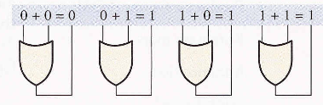
Boolean Addition
Boolean addition is equivalent to the OR operation.

Slide 4
SUM TERM
In Boolean algebra, a sum term is a sum of literals.
In logic circuits, a sum term is produced by an OR operation with no AND operations involved.
Examples:
A sum term is equal to 1 when one or more of the literals in the term are 1. A sum term is equal to 0 only if each of the literals is 0.
determine the values of A, B, C, D that makes the sum term equal to 0.

Slide 5
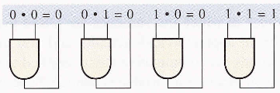
Boolean Multiplication
Boolean Multiplication is equivalent to the AND operation (The AND gate is a Boolean multiplier)

Slide 6

Product term
In Boolean algebra, a product term is the product of literals.
In logic circuits, a product term is produced by an AND operation with no OR operations involved.
Example of product terms:
A product term is equal to 1 only if each of the literals in the term is 1. A product term is equal to 0 when one or more of the literals are 0.
Example: Determine the values of A, B, C, D that make product term equal to 1.

Slide 7
Laws and Rules of Boolean algebra
These are well-developed rules and laws that must be followed in order to properly apply Boolean algebra.
The basic laws of Boolean algebra – the commutative laws for addition and multiplication, the associative laws for addition and multiplication, and the distributive law are the same as in the ordinary algebra.

Slide 8
Commutative Law
The commutative law of addition for two variables is written:
A + B = B + A
This law states that the order in which the variables are ORed makes no difference.
The commutative law of multiplication for two variables is AB = BA
This law states that the order in which the variables are ANDed makes no difference

Slide 9

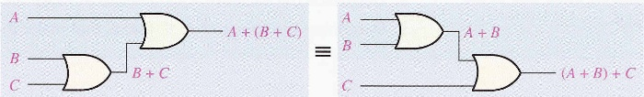
Associative Law
The associative law of addition is written as follows for three variables,

Slide 10
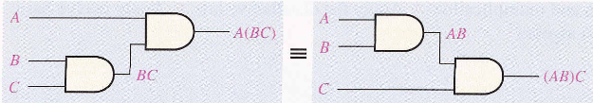
The associative law of multiplication is written as A(BC) = (AB)C
This law states that it makes no difference in what order the variables are grouped when ANDing more than two variables

Slide 11
Distributive Law
The distributive law is written for three variables:
A(B + C) = AB + AC
This law states that ORing two or more variables and then ANDing the result with a single variable is equivalent to ANDing the single variable with each of the two or more variables and then Oring the products.
The distributive law also expresses the process of factoring in which the common variable A is factored out of the product terms.
AB + AC = A(B + C)

Slide 12
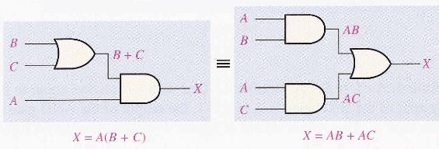
Distributive law in terms of Gate implementation

Slide 13
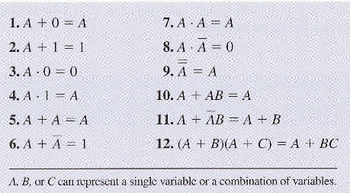
Rules of Boolean Algebra

Slide 14
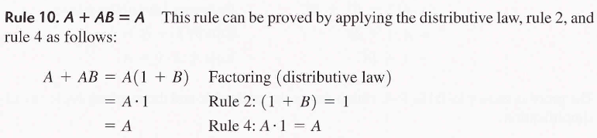

Slide 15
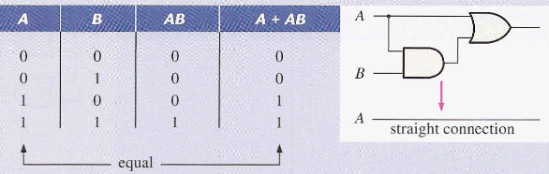
proof

Slide 16
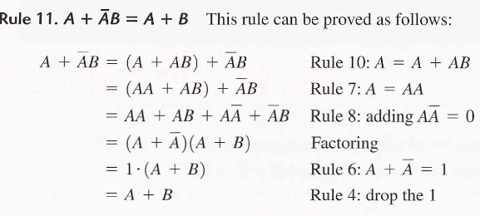

Slide 17
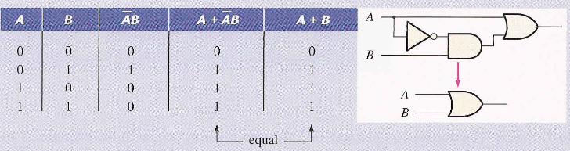

Slide 18
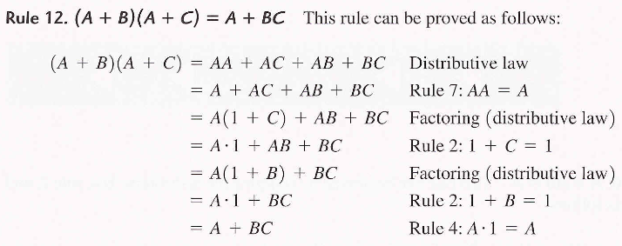

Slide 19
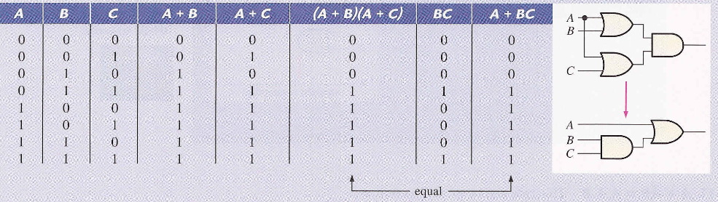

Slide 20

DeMORGAN’S THEOREM
DeMorgan’s first theorem;
The complement of a product of variables is equal to the sum of the complements of the variables.
Also stated as The complement of two or more ANDed variables is equivalent to the OR of the complements of the individual variables.

Slide 21
DERMORGAN’S THEOREM
DeMorgan’s second theorem:
The complement of the sum of variables is equal the product of the complements of the variables.
Stated as
The complement of two or more ORed variables is equal to the AND of the complements of the individual variables.

Slide 22

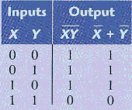

Slide 23

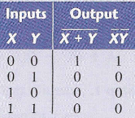

Slide 24

Example, for three variables we have:
Example: Let X=AB + C and Y=A + BC apply DeMorgan’s theorem stated by

Slide 25



Procedure for applying Demorgan’s theorems
Example
Step 1. Identify the terms to which you can apply Demorgan’s theorems.
Example Let
Step 2. Apply the two DeMorgan’s theorems whenever applicable.
Note: Always use rule 9 to cancel the double bars over a term.

Slide 26
BOOLEAN ANALYSIS OF LOGIC CIRCUITS
Boolean algebra provides a way to express the operation of a logic circuit formed by a combination of logic gates.
This is so that the output can be determined for various combinations of input values.
To derive the Boolean expression for a given logic circuit, begin at the left-most inputs and work towards the final output.

Slide 27
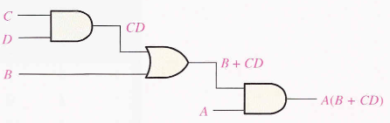
Boolean Expression for a Logic circuit
To Construct the Truth table for the logic circuit:
use the final expression of the logic circuit to construct the Truth table

Slide 28
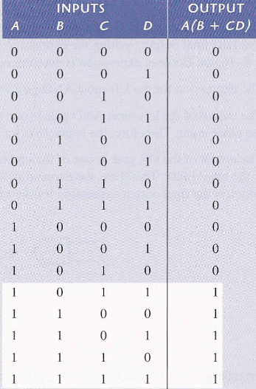

Slide 29
example
Replace the AND gate with OR gate and the OR gate with an AND gate and determine the Boolean expression for the output.
Construct the truth table for the circuit.

Slide 30

SIMPLIFICATION OF LOGIC CIRCUITS USING BOOLEAN ALGEBRA
Simplify the expression using rules of Boolean algebra.
.

Slide 31
The answer is:
Draw the logic circuits for both expressions.

Slide 32
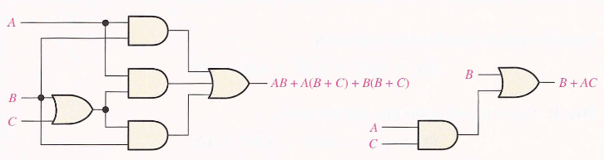
These logic circuits are equivalent ( for any combination of levels on the A,B,C inputs you get the same output from either circuits).
One is more convenient to implement than the other (and cheaper since it requires only two gates instead of five)

